Slide 1
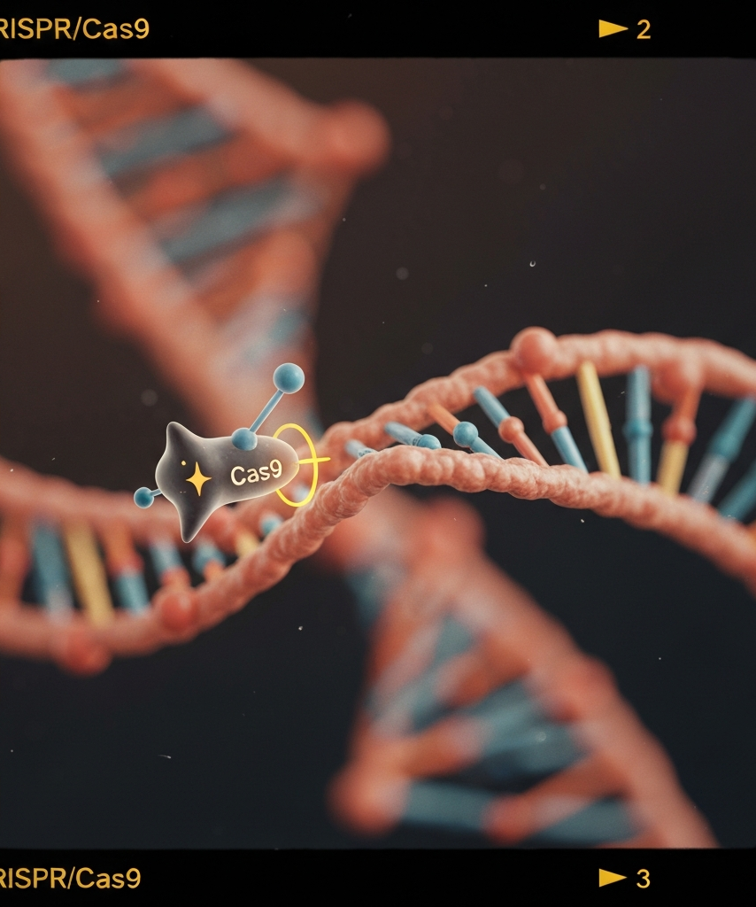
CRISPR: From Discovery to Clinic
An introductory overview of the groundbreaking CRISPR gene editing technology, its discovery, and its transformative potential in the medical field.

Slide 2
Presentation Overview
CRISPR Discovery and Key Figures
Highlights the contributions of Jennifer Doudna and Emmanuelle Charpentier in the development of CRISPR technology.
CRISPR Mechanism of Action
Explains the CRISPR mechanism, including target selection, DNA cutting, and the two main repair pathways.
CRISPR Breakthroughs Timeline
Outlines the key breakthroughs in the development of CRISPR technology from 2012 to the anticipated first regulatory approvals in 2023-2024.
CRISPR Delivery Modalities
Discusses the different delivery modalities for CRISPR-based therapies, including AAV, LNPs, and ex vivo electroporation.
CRISPR Therapeutic Pipeline
Categorizes the CRISPR therapeutic pipeline into various disease areas and provides representative programs for each category.
CRISPR Market Outlook
Includes a projected global CRISPR therapeutics revenue scenario, with projections for 2024, 2027, and 2030.
Clinical Risks, Ethics, and Regulation
Delves into the clinical risks, ethical considerations, and regulatory landscape related to CRISPR-based therapies.

Slide 3

Jennifer Doudna and Emmanuelle Charpentier
Jennifer Doudna, a biochemist at UC Berkeley, and Emmanuelle Charpentier, a microbiologist, co-discovered the CRISPR-Cas9 genome editing system in 2012. Doudna pioneered the governance and ethical discourse surrounding genome editing, while Charpentier identified the tracrRNA and co-invented the CRISPR-Cas9 system. Both were awarded the 2020 Nobel Prize in Chemistry for their groundbreaking work.

Slide 4



How CRISPR Works
Target Selection
DNA Cutting
DNA Repair Pathways
The Cas9 enzyme scans the DNA for a specific protospacer adjacent motif (PAM) sequence, typically NGG. Once the PAM is identified, the 20-nucleotide guide RNA (gRNA) base-pairs with the complementary DNA sequence, allowing the Cas9 to recognize and bind to the target site.
The Cas9 enzyme has two domains - HNH and RuvC - that cleave the DNA strands on opposite sides, creating a double-strand break (DSB) in the target DNA sequence.
After the DNA is cut, two main repair pathways can occur: 1) NHEJ (Non-Homologous End Joining), an error-prone process that often results in small insertions or deletions (indels), frequently leading to gene knockout, and 2) HDR (Homology-Directed Repair), which allows for precise edits or insertions at the break site with the presence of a donor template.

Slide 5
CRISPR Breakthroughs Timeline
2012
2016
2021
Initial proof-of-concept demonstration of RNA-guided DNA cleavage
Development of CRISPR base editors for precise single-nucleotide conversions
First in vivo CRISPR infusion showing strong target knockdown in clinical trial
2018
2013
2023-2024
First in vivo CRISPR therapy trial for Leber congenital amaurosis type 10
First use of CRISPR-Cas9 for genome editing in human cells
Anticipated first regulatory approvals of a CRISPR therapy

Slide 6
CRISPR Delivery Modalities
Comparison of key attributes across different CRISPR delivery modalities (AAV, LNP, ex vivo electroporation)
90%
80%
70%
60%
50%
Cargo Capacity
Tropism & Transduction Efficiency
Potential for Repeat Dosing
Manufacturing Complexity
Off-Target Editing Minimization

Slide 7
CRISPR Therapeutic Pipeline Landscape
Hematology (ex vivo)
Cardio-metabolic (in vivo, liver)
Ophthalmology (in vivo, ocular)
Indications: Sickle cell disease, β-thalassemia Representative programs: Exagamglogene autotemcel (exa-cel/CASGEVY) - a CRISPR/Cas9 RNP edit of autologous hematopoietic stem and progenitor cells (HSPCs) targeting the BCL11A enhancer; Base-edited HSPCs (e.g., BEAM-101)
Indications: ATTR amyloidosis, Hypercholesterolemia (PCSK9), Lp(a) lowering Representative programs: NTLA-2001 (CRISPR/Cas9 mRNA + gRNA LNP for TTR knockout), VERVE-101 (adenine base editor mRNA + gRNA LNP for PCSK9)
Indications: LCA10, Choroideremia Representative program: EDIT-101 (CRISPR/Cas9 AAV5 for CEP290 intronic splice editing)
Oncology (ex vivo)
Rare Genetic Diseases (various)
Indications: B-cell malignancies, Solid tumors (investigational) Representative programs: Multiplex-edited allogeneic CAR-T/NK cells (targeting PD-1, TRAC, B2M)
Indications: AATD, DMD, CNS and hearing loss targets (preclinical) Representative programs: Emerging in vivo prime/base editors, targeted LNPs/capsids

Slide 8


Market Outlook
Year
CRISPR Therapeutics Revenue ($ billions)
2024
0.6
2027
6.0
2030
18.0
*Source: Illustrative scenario from the provided market outlook context

Slide 9
Clinical Risks, Ethics, and Regulation
Off-Target Edits
Potential for unintended mutations at off-target sites, mitigated by high-fidelity Cas9 variants, optimized guide RNAs, and orthogonal off-target mapping techniques
On-Target Complexity
Large deletions, rearrangements, or activation of tumor suppressor pathways, mitigated by favoring base editors or prime editors, allele-aware design, and functional assays
Vector-Related Toxicity
Risks of genotoxicity and hepatotoxicity from viral vectors, mitigated by lower vector doses, integration site analysis, and comprehensive biodistribution and toxicology studies
Immunity to Cas Proteins or Vectors
Pre-existing or acquired immune responses can limit efficacy and safety, mitigated by pre-screening, using less-immunogenic Cas proteins, and prophylaxis with immunosuppressive regimens
Manufacturing and Product Variability
Ensuring consistent quality and potency of CRISPR-based products through in-process controls, potency assays, deep sequencing, and standardized analytical methods

Slide 10
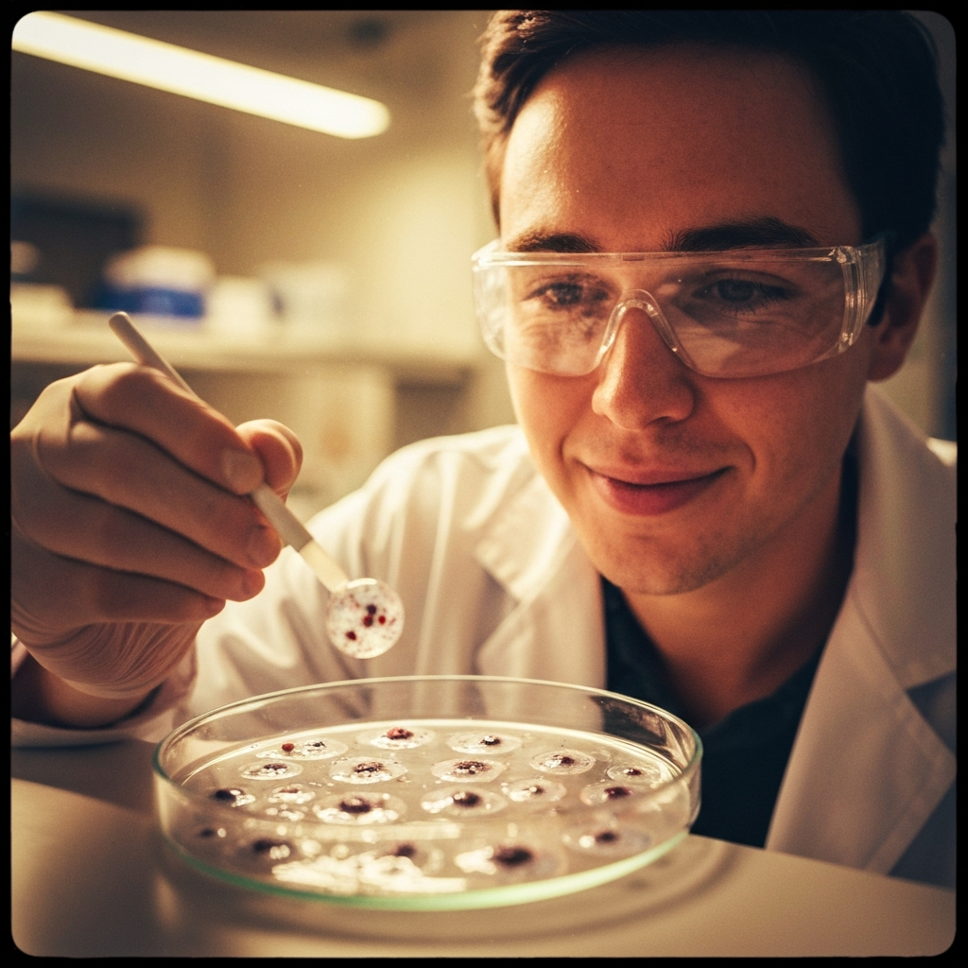
CRISPR technology has transformed the landscape of genetic engineering, offering unprecedented precision and possibilities for treating a wide range of diseases. As the field continues to evolve, it will be crucial to navigate the complex clinical, ethical, and regulatory considerations to ensure the safe and equitable development of CRISPR-based therapies that can truly benefit patients and society.

